Slide 1

GSOE9758
Project Topic: Radisson
Group number ：2
z5189004 Yu He
z5275261 Dongchen Liu
z5192843 Yuhan WANG
z5303449 Hanwei ZHANG
延时符

Slide 2
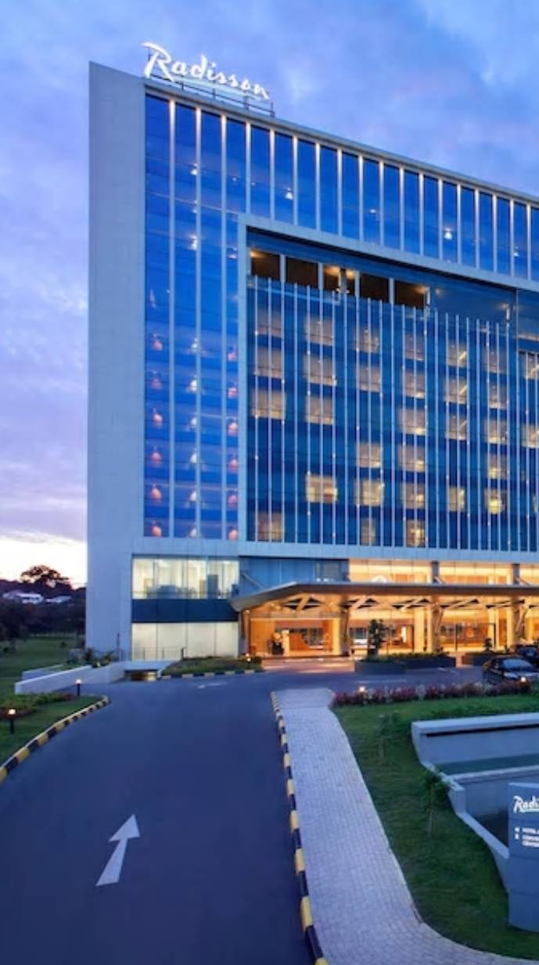
Background and History
Radisson Hospitality AB (publ) (“Radisson”) is one of the largest hotel companies in Europe, the Middle East & Africa. By the end of 2019, the group operated 387 hotels with 84,842 rooms in 66 countries.
1909 The first Radisson Hotel was opened, named after the famous French explorer Pierre Radisson.
1962 the Radisson Hotel was acquired by Minneapolis businessman and entrepreneur Curt Carlson, who pioneered the concept of a customer loyalty program.

Slide 3
Radisson Aspiration Objective and Strategy
Aspiration
We aim to become a top of mind hotel company in the world and a preferred choice for guests, owners, investors and talent, we celebrate our industry-leading commitment to ethical excellence, and we are recognized as a trusted global Responsible Business leader.
Objective
Creating memorable moments.
Being a true host and the best partner.
To further reduce our carbon & water footprint by 10%
To focus on human rights in the supply chain
Creating shared value in communities in the areas of food, shelter and a better future especially for disadvantaged children and youth.
Strategy
Think People – Caring about people in our hotels and value chain;
Think Community – Meaningful contributions to communities around the world;
Think Planet – A better planet for all.
Reducing our carbon footprint, energy, water and waste.

Slide 4
Business Model Canvas
Key Partners
Government（Tax bureau，Legal aid）
Venture Capital Institution
Architectural &design companies
‘Service Providers’ e.g. banks, food suppliers
Technical companies
Tourism company
Key Activities
Global services
Property management
Financial and invest activities
Charity activities
Franchise and Agency
Real estate activities
Value Proposition
Good brand reputation
Huge social influence
International chain company
Loyalty program
International first-class service
Comfortable environment
Relationships
Social media
Loyalty program
Network
24*7 customer service
Customers
hotel guest
Advertising companies
Hotel owners
business companies
Channel
Website
Mobile booking apps
Advertising board
Travel agent
Public praise
Key Resources
Excellent human resources
Brand influence
International reputation
Database
Real Estate
Cost Structure (€k)
2019 2018
Personnel cost 315,003 322,170
Rental expense 174,776 222,429
Cost of goods ( food&drinks.etc） 46,789 45,677
Running cost 64842 62210
Maintenance 14,753 14,397
marketing promotion 83,052 84,449
Other expenses 12,419 11,389
Revenue Streams(€k)
2019 2018
Management fee 105,129 103,732
Franchise fee 38,915 30,076
Leased 798,176 790,853
Other (from shared service centres) 8,129 7,446
Central activities 48,977 27,075
Notes:
From:

Slide 5
VGR of Radisson
V
Be the company of choices for guests, owners and talent.
G
Increase revenue by 6-7% annually from 2018 to 2022
Provide comprehensive and highly intelligent services
Achieve the Sustainable Development Goals by 2030
R
New operational& organizational model
New and differential Brand
Advanced web & mobile capabilities
Upgraded loyalty program
Save energy and reduce carbon emissions
Best-in-class IT platforms
High-quality service
Intelligent interactive devices for IOT
Scale initiatives

Slide 6
Mapping Requirements to Goals
Goals | Requirements
G1. Increase revenue by 6-7% annually from 2018 to 2022 | R1.1 New operational& organizational model
 | R1.2 New and differential Brand
 | R1.3 High-quality service
 | R1.4 Upgraded loyalty program
 | R1.5 Scale initiatives
G2. Provide comprehensive and highly intelligent services | R2.1 Advanced web & mobile capabilities
 | R2.2 Best-in-class IT platforms
 | R2.3 High-quality service
 | R2.4 Intelligent interactive devices for IOT
 | R2.5 Advanced web & mobile capabilities
G3. Achieve the Sustainable Development Goals by 2030. | R3.1 New operational& organizational model
 | R3.2 Save energy and reduce carbon emissions
 | R3.3 Intelligent interactive devices for IOT

Slide 7
Risk Management
2020
Covid-19
The significant drop in revenue
The liquidity available is severely impaired
Through the Group’s and the shareholders’ direct actions, liquidity and equity for the next twelve months are secured and the Group’s continued operations are not threatened. The Board of Directors and management closely follow developments to continue to take the necessary measures.
Temporary layoffs of personnel.
Rent negotiations and deferrals.
Application for governmental subsidies and loans.
Postponement of certain capex investments.

Slide 8
Thank You!
Group number ：2
z5189004 Yu He
z5275261 Dongchen Liu
z5192843 Yuhan WANG
z5303449 Hanwei ZHANG

